Slide 1

Energy Efficiency Optimization for Device-to-Device Communications in 5G Networks
VIDYA JYOTHI INSTITUTE OF TECHNOLOGY
PRESENTED BY
E.SREENATH(16911A04H4)
ZAKEER MOHAMMAD(15911A0460)
RAMGIRI VISHAL(16911A04G5)
PROJECT SUPERVISOR:
V.SRIDHAR
ASSISTANT PROFESSOR (PH.D)
ECE DEPARTMENT

Slide 2
CONTENTS
INTRODUCTION
OBJECTIVE
SYSTEM MODEL
SOFTWARE
APPLICATIONS
ADVANTAGES
DIS ADVANTGAES

Slide 3
AIM
To improve the performance of D2D communications in 5G networks by obtaining:
a.) Energy efficiency graphs.
b.) System through put graphs.
Apply adaptive genetic algorithm to solve EEO problem.

Slide 4
INTRODUCTION
The system characteristics of 5G net- works consist of high capacity, extremely low latency and very high data rate to support various media-rich mobile applications with stringent quality of service (QoS) requirements .
In D2D communications, mobile devices in close proximity can communicate directly with each other, instead of through a base station (BS).
D2D communications can support better local advanced services such as small-scale social networking, local advertising, local data sharing and Internet of Things (IoT) applications .

Slide 5
OBJECTIVE
The main purpose of our project is to improve the performance of D2D communications in 5G networks and arising energy power consumption in social-aware D2D communications .

Slide 6
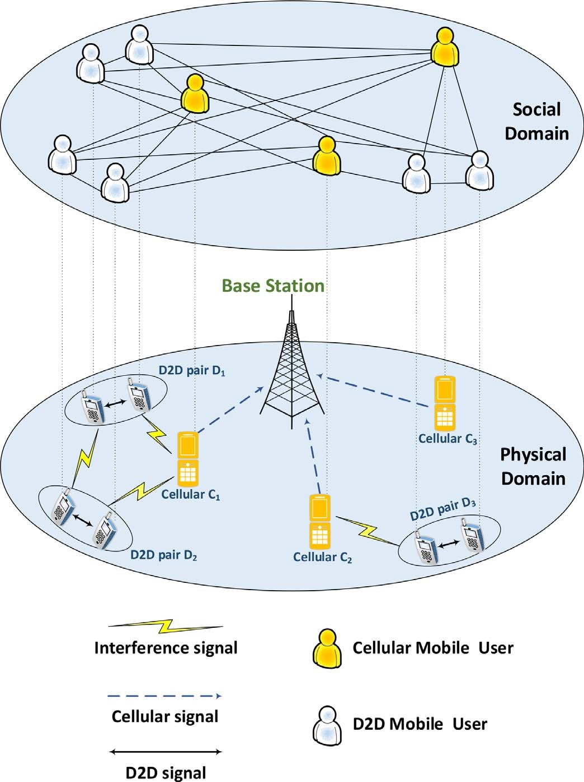
System Model

Slide 7
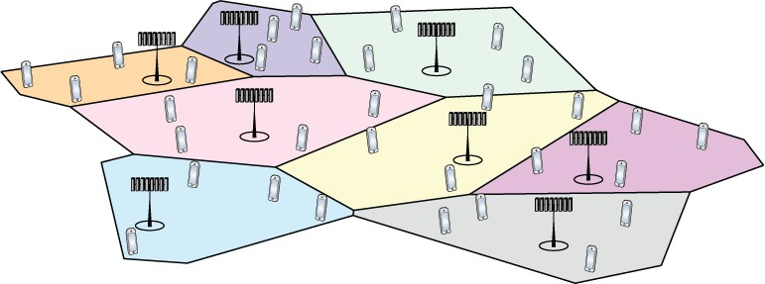
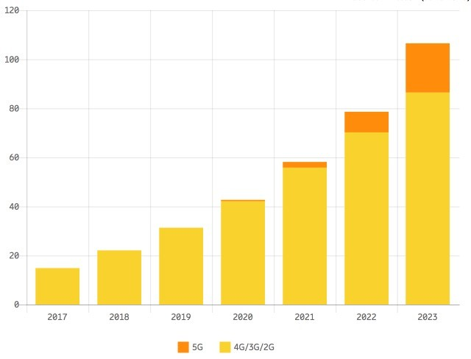
Exponential Traffic Growth in Cellular Networks
Exabyte/month
39% More Data Every Year
7x from 2017 to 2023
Video dominant application
Same trend for energy consumption?
Can we make 5G more energy efficient?
3

Slide 8
What is Energy Efficiency?
Benefit-Cost Analysis:
Cost:
Energy consumption
(Watt=Joule/s)
Benefit:
Data throughput
(bit/s)
Cellular network
Benefit-Cost Ratio:
Environmental concerns
Energy production is mainly non-renewable
Economical concerns
Energy price: Joule/€
Other costs can also be included
4

Slide 9
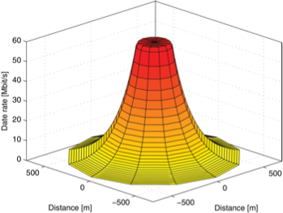

Potential Solution: Micro Cells
Base station
Signal power decays rapidly with distance
0.001% received at 1 m
0.00001% received at 10 m
Faster decay in non-line-of-sight
Rapid decay
Smaller cells → Lower loss → Reduce power
1 km²
Tradeoff: Energy consumption [Joule/s/km²] = Transmit power + Circuit power

Slide 10
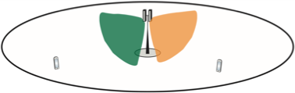
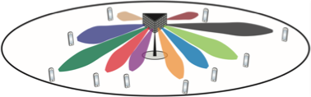
Potential Solution: Massive MIMO (multiple-input, multiple-output)
Direct signals by beamforming
Use antenna array
Higher received power
Spatial multiplexing
Few antennas: Broad beams
More antennas → Reduce power, multiplex users
Throughput
Tradeoff: Transmit power + Circuit power
Massive number of antennas: Narrow beams

Slide 11
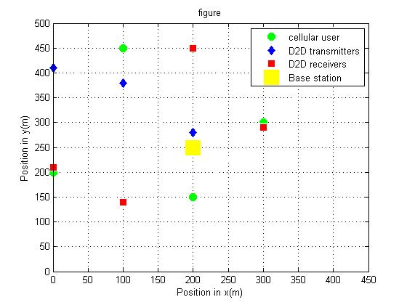
Results: Network layout

Slide 12
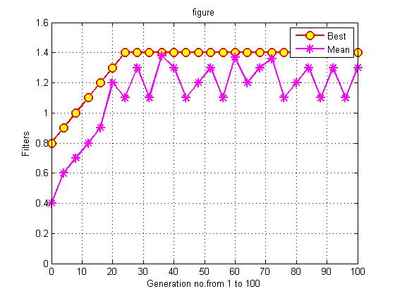
Convergence Rate of Adaptive GA

Slide 13
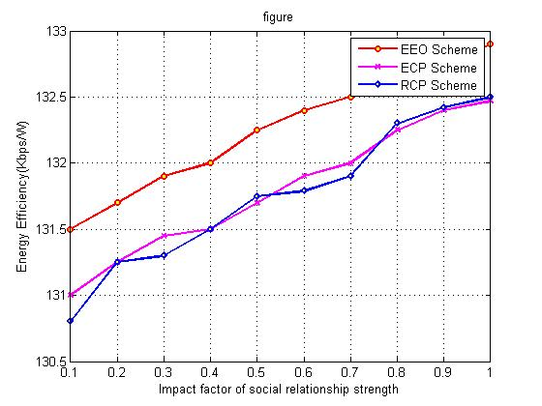
Energy Efficiency vs. α

Slide 14
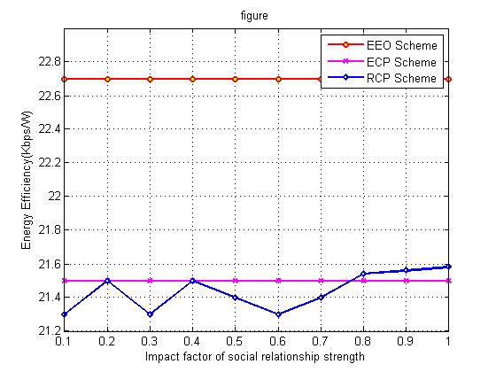
System Throughput vs. α

Slide 15
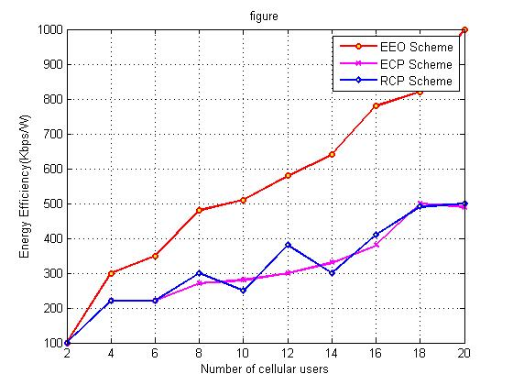
Energy Efficiency vs. NC

Slide 16
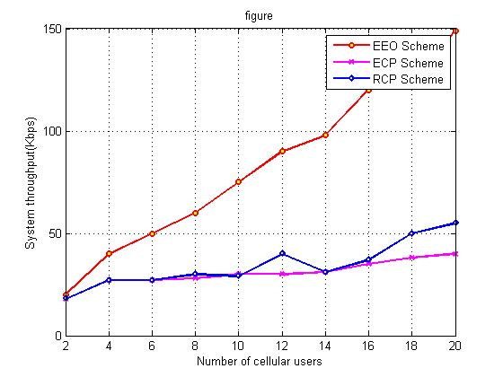
System Throughput vs Nc

Slide 17
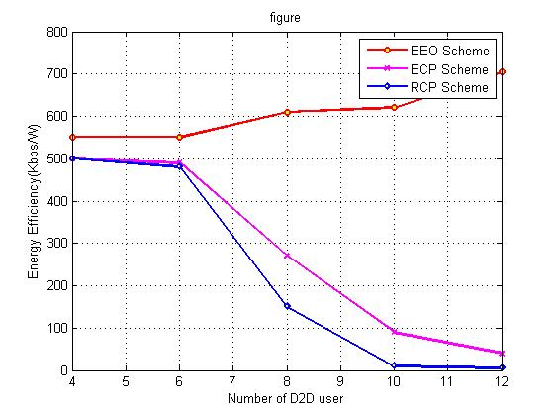
Energy Efficiency vs ND

Slide 18
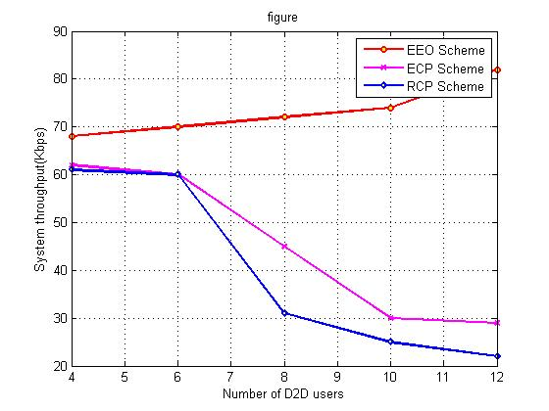
System Throughput vs. ND

Slide 19
Applications
Local service
Emergency communication
IoT Enhancement
Vehicle-to-vehicle communication
Remotely monitored smart sensors

Slide 20
Advantages
Improve throughput
Energy efficiency
Delay

Slide 21
Disadvantages
Complex billing system.
Additional hardware required for D2D and cellular communication.
Limited Range.

Slide 22
THANK YOU

